Slide 1
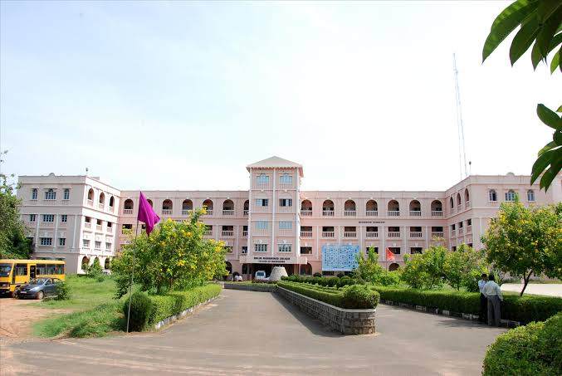

AALIM MUHAMMED SALEGH COLLEGE OF ENGINEERING
O MY LORD INCREASE ME IN KNOWLEDGE
COLLEGE CODE : 1101

Slide 2
Python programming
Department of Computer Science and Engineering

Slide 3
Problem Statement
Write the program to calculate area of Circle in python.

Slide 4
Understand the problem
r
D

Slide 5
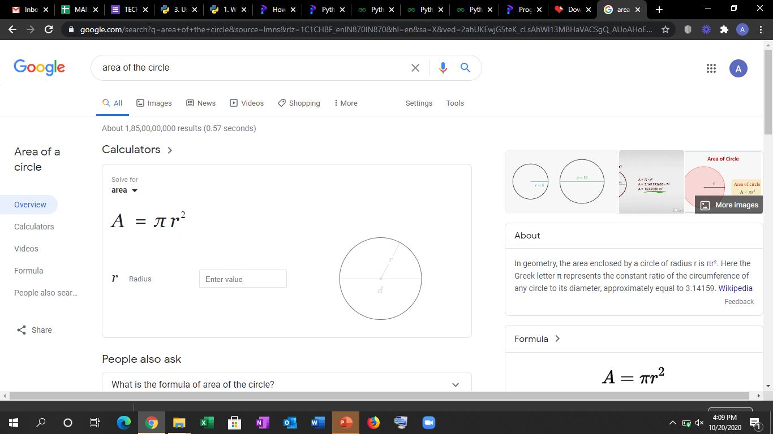
Example

Slide 6

Solution Requirement and Evaluation
DO CALCULATE AREA OF CIRCLE
TELL ME THE STEPS

Slide 7
Brain Storming - Step 1
Formula

Slide 8
Have It !
AREA OF CIRCLE=πr²

Slide 9
Brain Storming – Step 2
WHAT IS π?

Slide 10
Have It !
Π=3.14

Slide 11
More on Pi value
Pi=3.14
pi variable(name to the variable)
3.14 value of the pi which we want use

Slide 12
ALGORTHEMIC STEPS
Start the Program
Initialize the variables
Get the radius.
Give the formula to calculate
Display the output
Stop the program

Slide 13
FLOWCHART
start
Enter the radius
Area=3.14*r*r
Print the area
stop

Slide 14
Code Building for INPUT value
r=float(input("enter the radius of the circle:"))
r variable name
float data type
input inbuilt function to get the value from the user

Slide 15
Calculation using Formula for area
area = pi*r*r
area variable name(area)
pi variable name(3.14)
r variable (radius)

Slide 16
Code Building for PRINT value
print("The area of the circle is :%.2f"%area)
print inbuilt function for doing display operation
“ type to print”
%.2f format specifier with allowing two decimal digits
%area getting the value to display on the screen

Slide 17
IMPLEMENTATION OF CODE
INSTALLATION
Make sure python 3.9 has installed in the system .
If not you can download go to https://www.python.org/downloads/
Execute the app.
Do not disturb till the installation process complete.

Slide 18
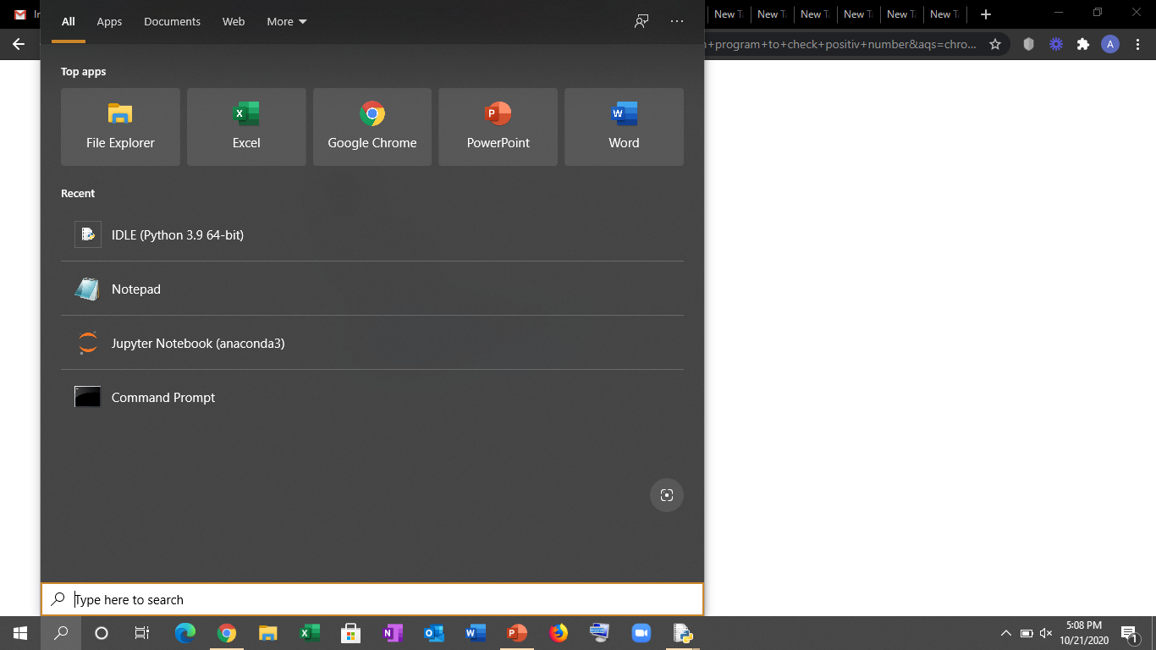
Steps to run program
Go to search in the computer

Slide 19
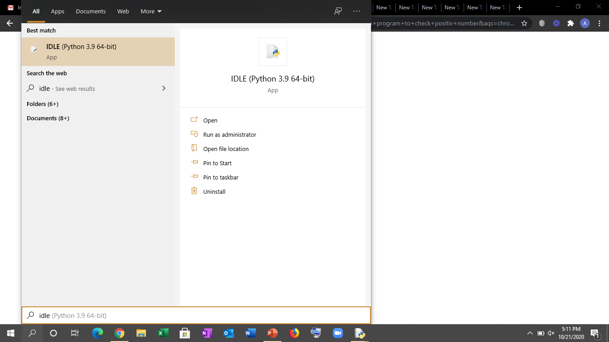
Type IDLE and click on python idle.

Slide 20
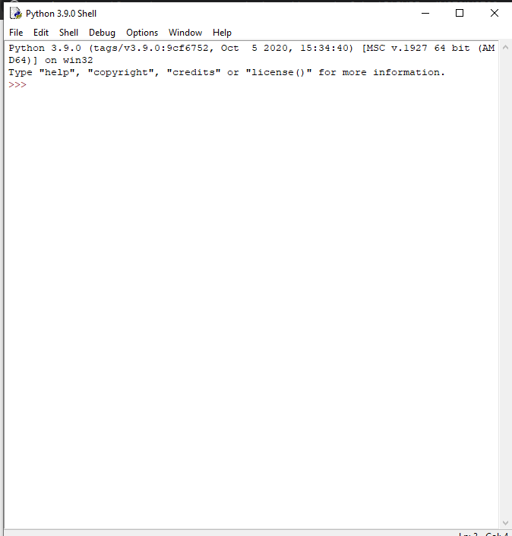
We will receive the python shell

Slide 21
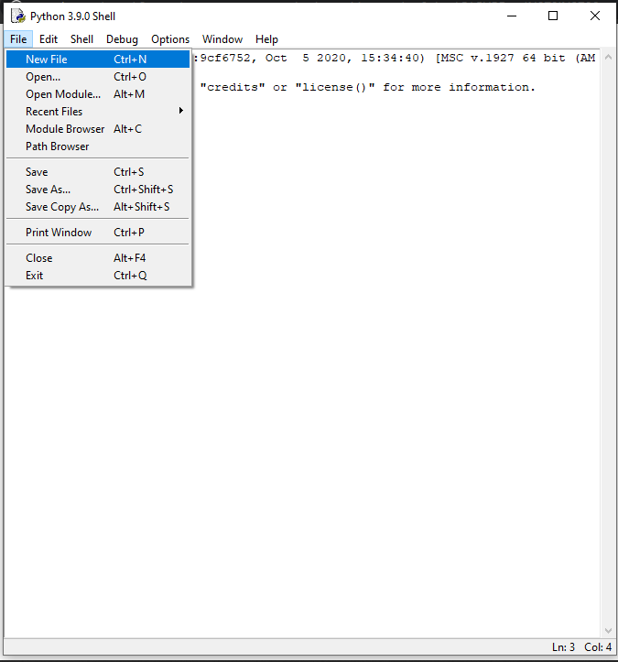
Create new python file

Slide 22
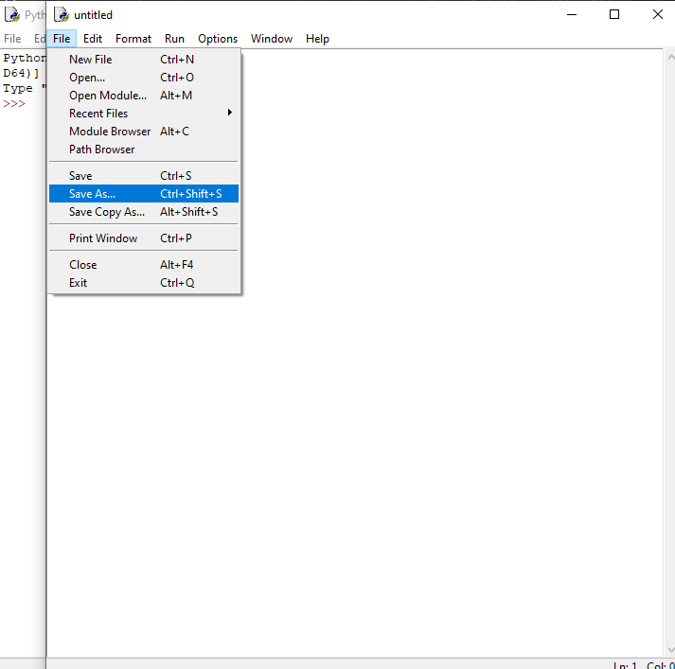
Type the python code and click save as.

Slide 23
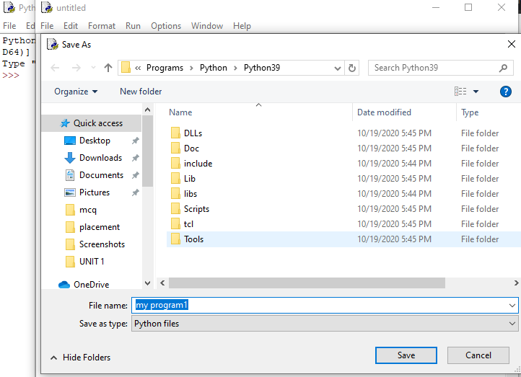
Save the file as python file
and give the name.
Click on SAVE.

Slide 24
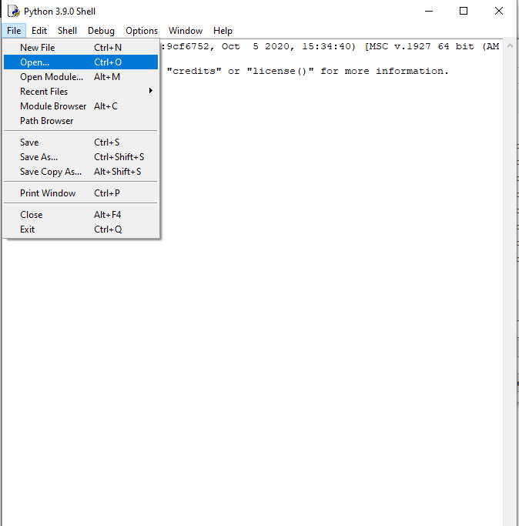
Go to OPEN

Slide 25
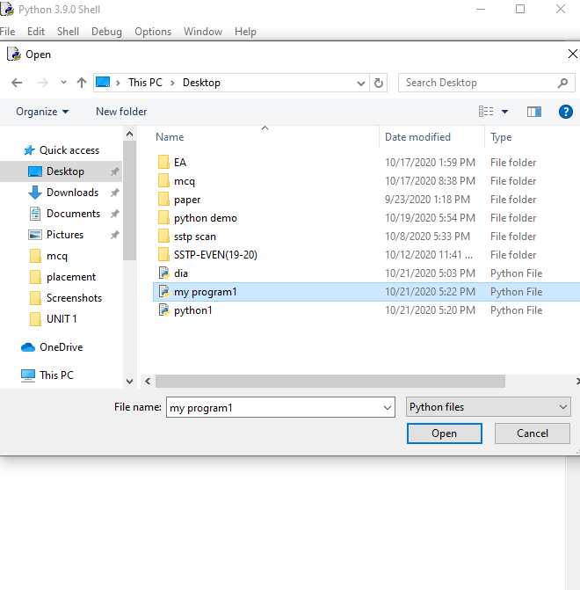
Select the python file

Slide 26
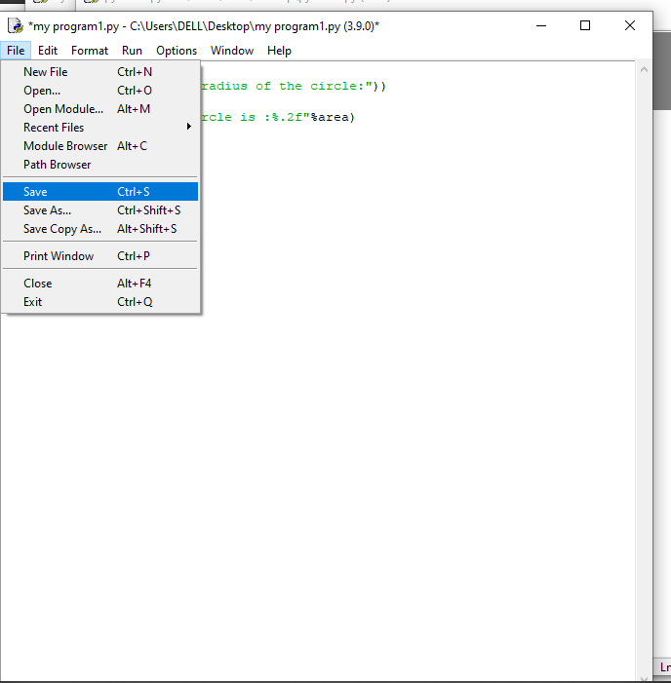
Save the file after you complete
the code file

Slide 27
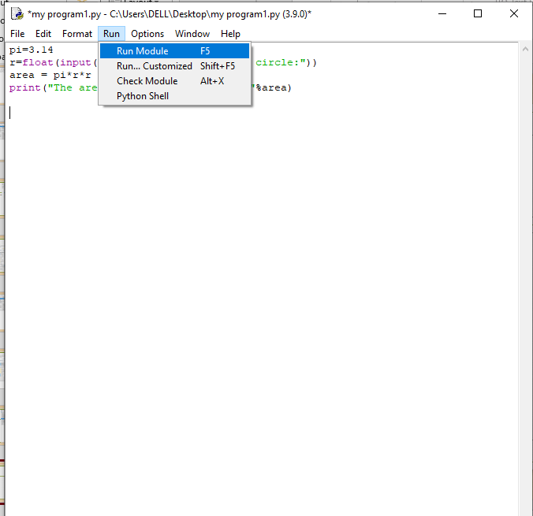
Click on run module to run
the program
We will get the ouput or error if
any.

Slide 28
THANK YOU

